Slide 1
DiceWars
Simon Christofzik, Olga Lapidus(Gruppe 3)

Slide 2
Inhalt
Git
Scrum
Structure 101 (Architektur)
Sonar
Jenkins
Code Coverage
Pom file
Cost Estmation
Patterns
Dependency Injection
TUI Development
GUI Development

Slide 3
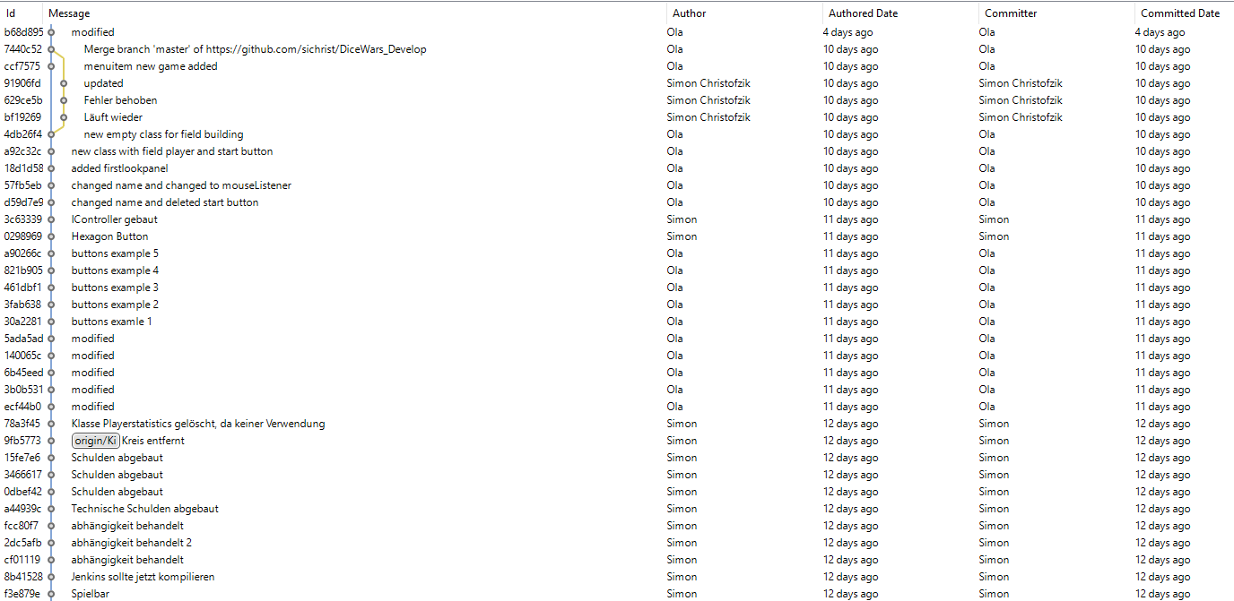
Git

Slide 4
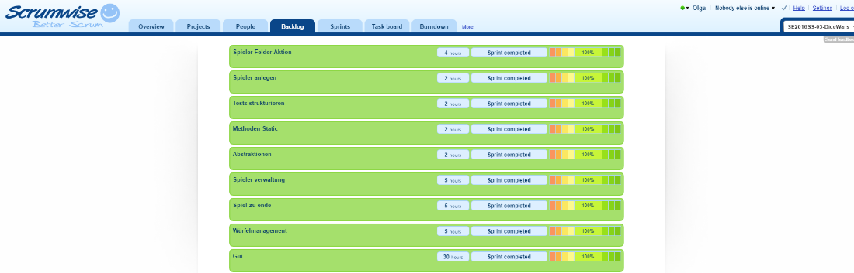
Scrum

Slide 5
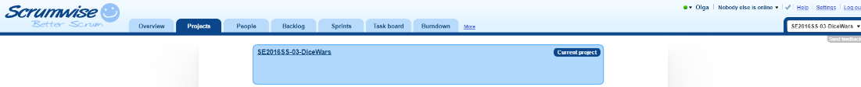
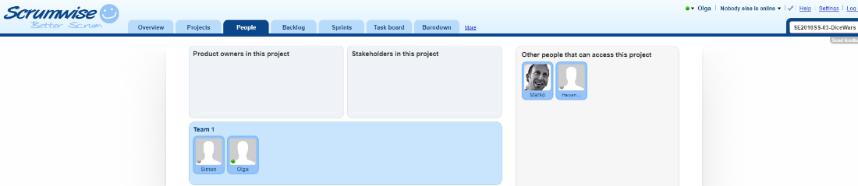
Scrum(2)

Slide 6
Structure 101, Architektur

Slide 7
Sonar

Slide 8
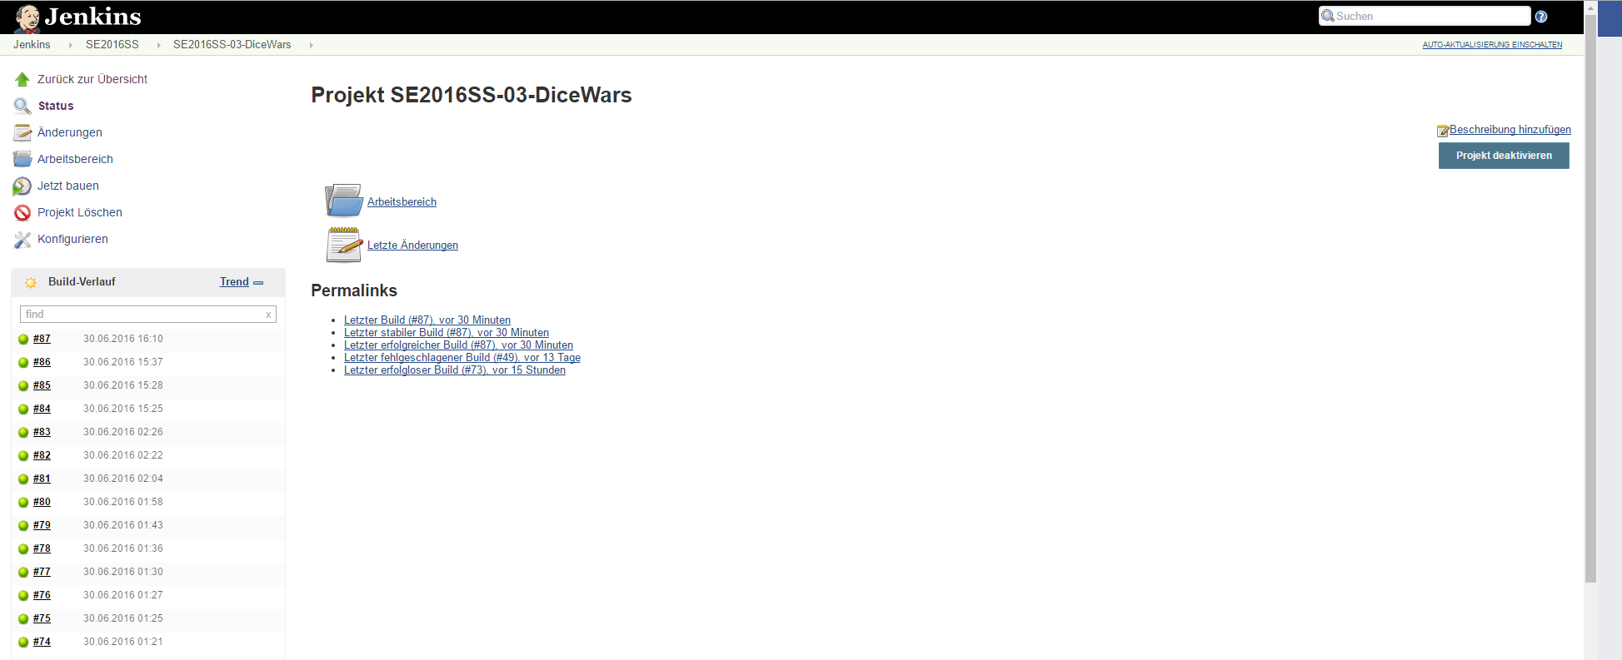
Jenkins

Slide 9
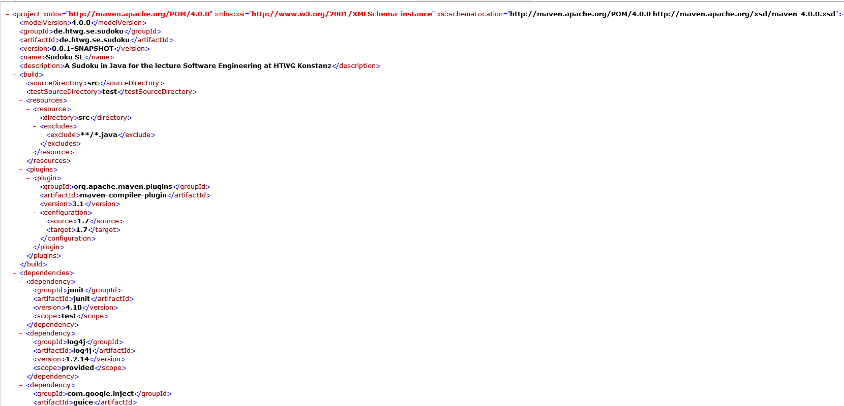
Pom

Slide 10
Cost Estimation

Slide 11
Patterns

Slide 12
Dependency Injection

Slide 13
TUI Development

Slide 14
GUI Development

